Slide 1
Move database api - http://docs.themoviedb.apiary.io/#reference/changes/moviechanges
Api_key: 9bcc7d5492fb90c523ac4607906011eb

Slide 2
Login
Connecting to the Network
The Movie Fan
http://developer.android.com/training/basics/network-ops/connecting.html
Email
Password
Log in
Sign up

Slide 3
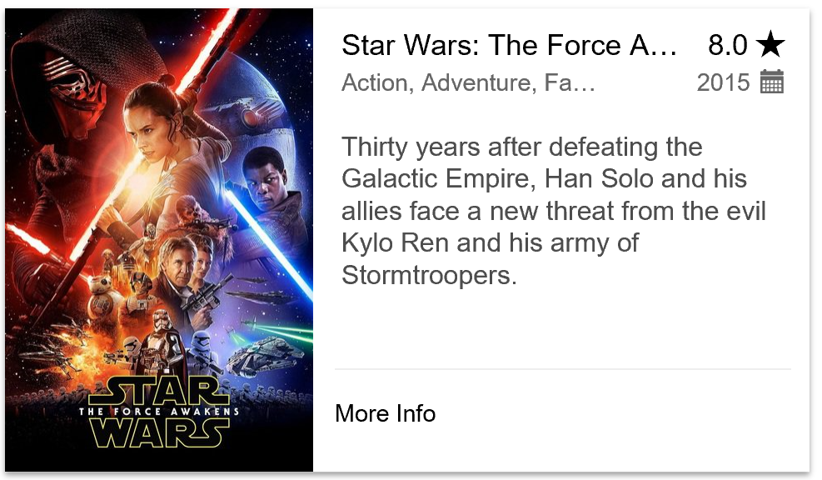
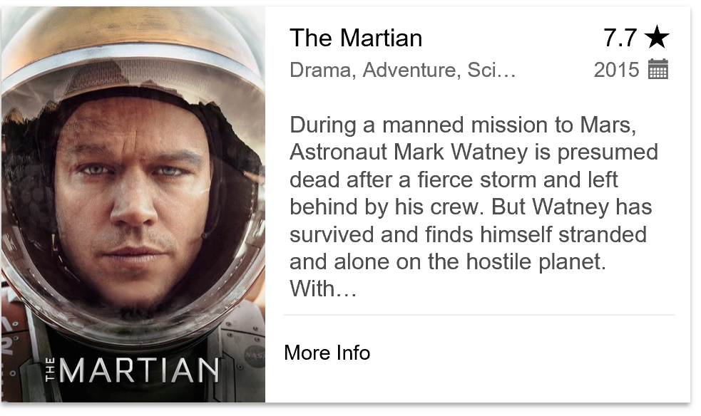
Home Page
Popular Movies
Gets popular movies from Movie database:
- filter by rank and date

Slide 4



Add to favorites
Details about a movie that the fan has seen. Including:
Fan rank
Fan notes about the movie
Fan pictures about the movie (taken with the camera at the premiere for instance)
Add to favorites
Save
The Martian
Overview
During a manned mission to Mars, Astronaut Mark Watney is presumed dead after a fierce storm and left behind by his crew. But Watney has survived and finds himself stranded and alone on the hostile…
My Rank:
8
Notes
Great movie, want to see it again.
Fan Photos
Add

Slide 5

Add photo
Details about a movie that the fan has seen. Including:
Fan rank
Fan notes about the movie
Fan pictures about the movie (taken with the camera at the premiere for instance)
Add Photo
Save
Notes

Slide 6
Movies to see
Movies to see

